Slide 1


CS542 Final Project --- Stock market simulation system
CHENGJIAO YANG
JIAN QIAO
YANG ZHENG

Slide 2

Project Purpose
Build up a more convenient and practical stock market training system avoiding real financial risk;
Make it easier for everyone around the world to access the training system;
Reproduce or duplicate some or all features of a live stock market on a computer basing on database management.

Slide 3

Project Management
Agile development;
Version Control: Github;
Document sharing: Word online.

Slide 4
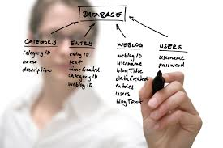
Project Design
Program Architecture;
Database design: ER map;
UI Design: Web Server API; JAVA Desktop Client; Html Client.
Workflow: Activity Diagram;

Slide 5
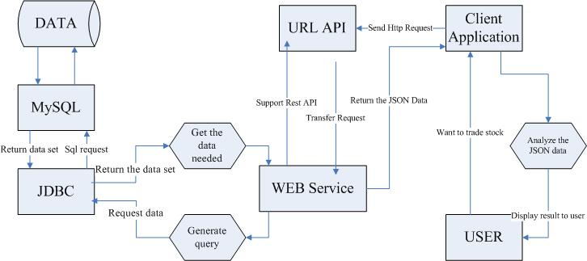
Program Architecture
Server
Client

Slide 6
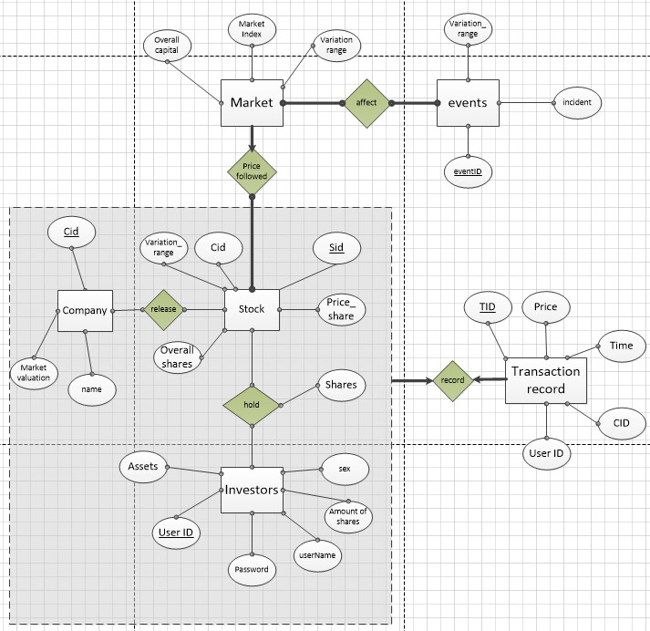
Database Design – ER map

Slide 7
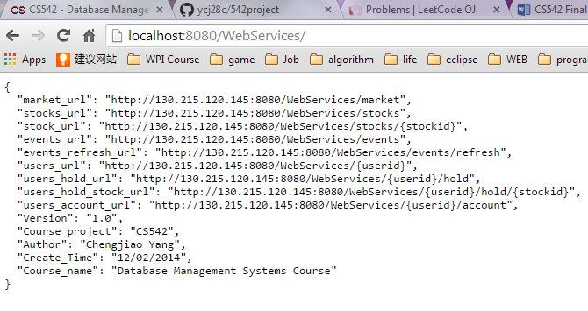
UI -- Web Server API

Slide 8
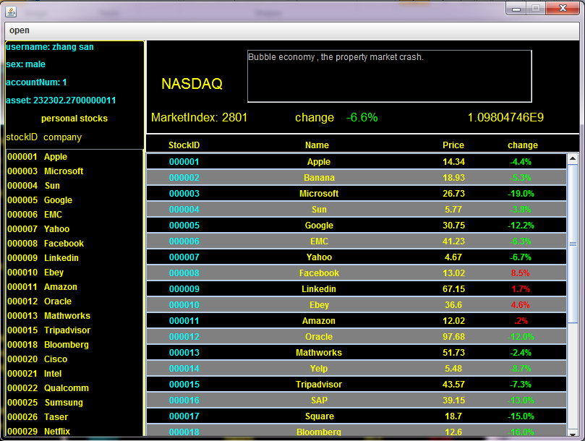
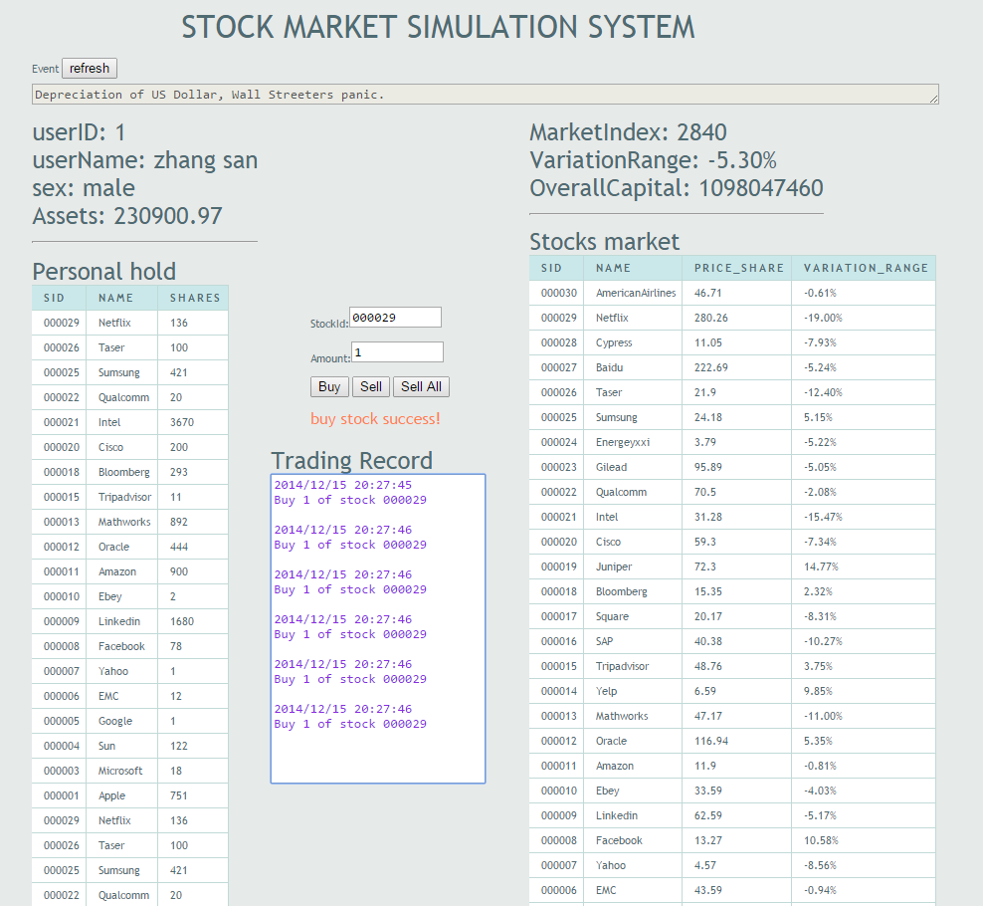
UI -- Two Versions of Client
JAVA Desktop Client
Html Client

Slide 9
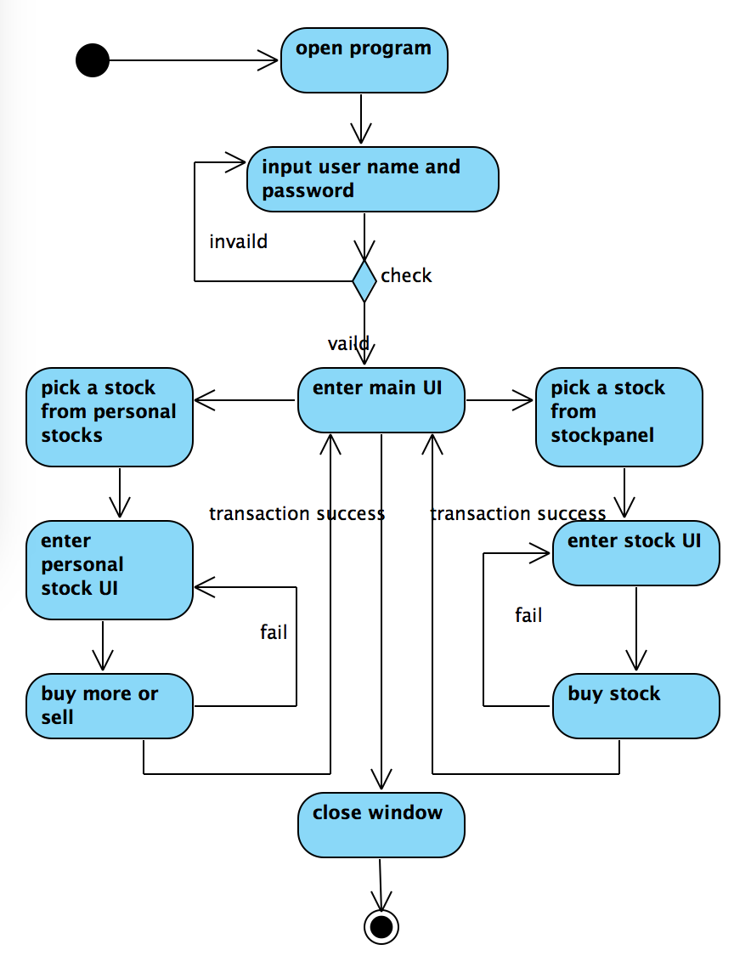
Workflow -- Activity Diagram

Slide 10
Tools
We use lots of develop tools and assist tools such as:
Develop and DB tools: MySQL5.7; Eclipse Juno; Java1.7
Rest WebService tools: Jersey2.13; glassfish4
Management tools: Github; Word online; MAVEN; MySQL Workbench 6.2 CE; phpAdmin
Eclipse Plugin: Egit; Windowsbuilder; Swing; AmaterasUML; Fatjar
Library: forms-1.3.0; mysql-connector-java-5.1.29-bin; json20090211; jackson1.9.12; gson2.2.4
Web tools: CSS2.0; html5; JQuery-1.8.2; Ajax; CORS
Design pattern: Factory design pattern in Java
Those tools help us to complete the development task much faster and more efficient.

Slide 11

Program Show

